Slide 1
Reflex Overview and Architecture
Module 1

Slide 2
Building Big Data Applications: Review
Challenges
Lack of Tooling for end-to-end App development
Lack of Talent
Many ingestion frameworks (Talend, Nifi, Logstash etc)
Many Data processing frameworks(MR, Spark, Spark Streaming etc)
Many Data Models (Key-Value, Columnar, Graph, In-memory etc)
Learnings
One framework is not enough.
Use the right tool for the job.
De-couple pipeline stages
Think hard about your data models
Notes:
Components/Tools to build end-to-end big data applications
Organizations have invested in build data lakes but they are not able to optimally leverage them because of lack of tools/applications/frameworks that allow them to build applications on top of the data lake. RAF allows you to leverage your data warehouse/data lakes by providing you end-to-end big data application development tools/components/integrations.

Slide 3
Introducing Reflex

Slide 4
Reflex (1)
Makes it easy to build end-to-end big data applications.
Multiple data ingestion tool choices (per use case)
Simplifies data processing
Analytics
Notebook support
Model Management Framework
Model Deployment
Extends data model portfolio with:
For search use cases (ES)
For graph use cases (JanusGraph)
For in-memory key-value store (Redis)
Notes:
Components/Tools to build end-to-end big data applications
Organizations have invested in build data lakes but they are not able to optimally leverage them because of lack of tools/applications/frameworks that allow them to build applications on top of the data lake. RAF allows you to leverage your data warehouse/data lakes by providing you end-to-end big data application development tools/components/integrations.

Slide 5
Reflex (2)
7. Data Bus (Kafka) based processing
8. UI
UI Toolkit(HTML5/Angular)
SuperSet+/Kibana for presentation layer
9. Due diligence before tool/framework integration
10. Allows you flexibility to integrate specific tools with Kubernetes/Docker.

Slide 6
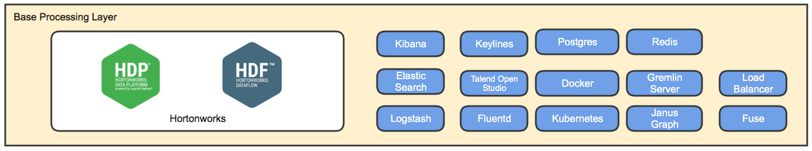

Reflex Architecture
Security
App1
Dev Ops
App2
AppN
Ingestion Plugins
Data Processing Plugins
Analytics Plugins
User Interface Plugins
Authentication
Parsers
Graph
Rules Engine **
Continuous Integration
Authorization
Feature Primitives
ML Plugins
Components
Continuous Deployment**
Adaptors
Search
Source/
Sink
Encryption **
Test Automation
Key Management **
Data Processing Frameworks
Analytics Engine **
User Interface Frameworks
OAM
Ingestion Frameworks
Data Mgmt Service **
IB Mgmt
Ingestion Service
Feature Engineering
Model Management
Model Selection
UI Toolkit
Provisioner
Audit Logs
Collector
Interactive Execution
CDAP+
Model Deployment
ML Automation
Superset+ **
Bare Metal/ Virtualized/ Cloud Environment
** Currently under development

Slide 7
Ingestion
Ingestion Framework selection may be based on:
Connectors
Parsers
UI Support
Pull/Push Model
Data formats
Data provenance capabilities
Transformation/Processing capabilities
Batch/Realtime
No single framework handles all requirements efficiently.
So, Reflex offer you multiple ingestion frameworks. You can use the one suitable to use case.

Slide 8
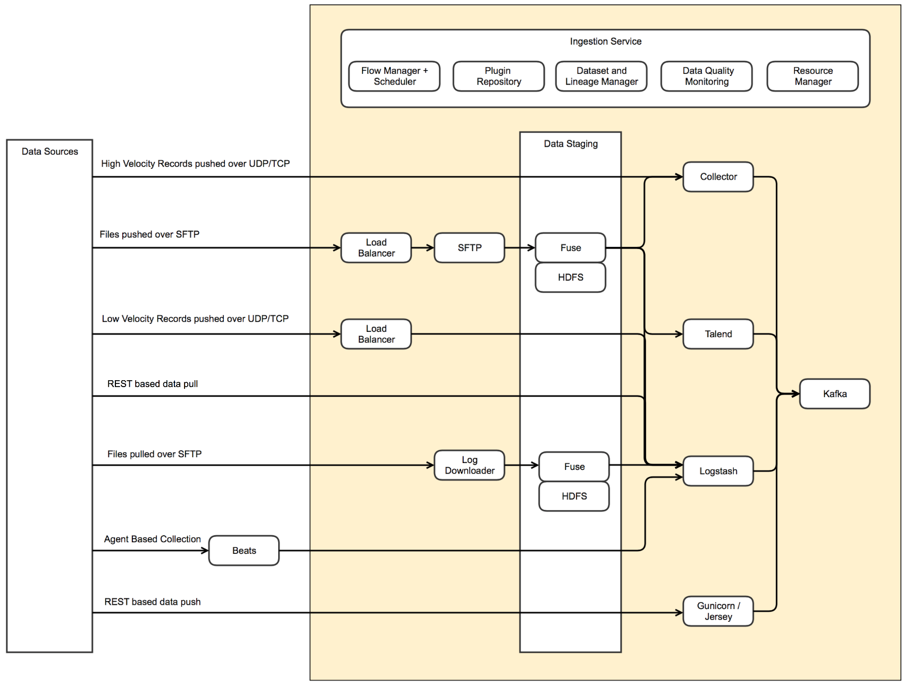

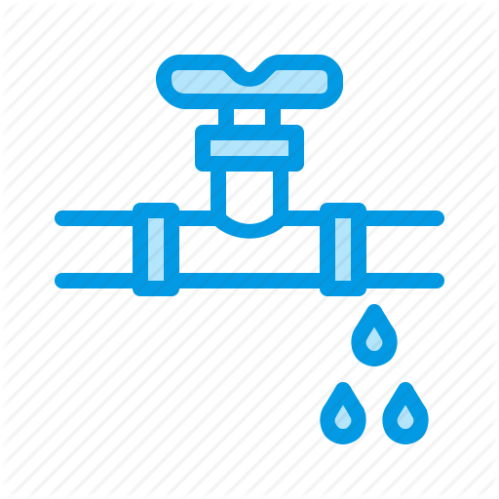

Ingestion
Extend reach to data sources
Never lose data
Gatekeeping of incoming data quality
Kafka
Kafka
Kafka
Notes:
Extend reach to data sources:
Optimized collection of high velocity data with low hardware footprint
No single ingestion framework is best-fit for all types of data. Reflex ingestion service hides the variations from user
Never lose data
Pre-formed data ingestion pipelines designed for data resiliency
Data staging to prevent backpressure on source
Gatekeeping of incoming data quality:
Data Quality Monitoring through row-level statistics and alerts
Normalization of data from various data sources

Slide 9
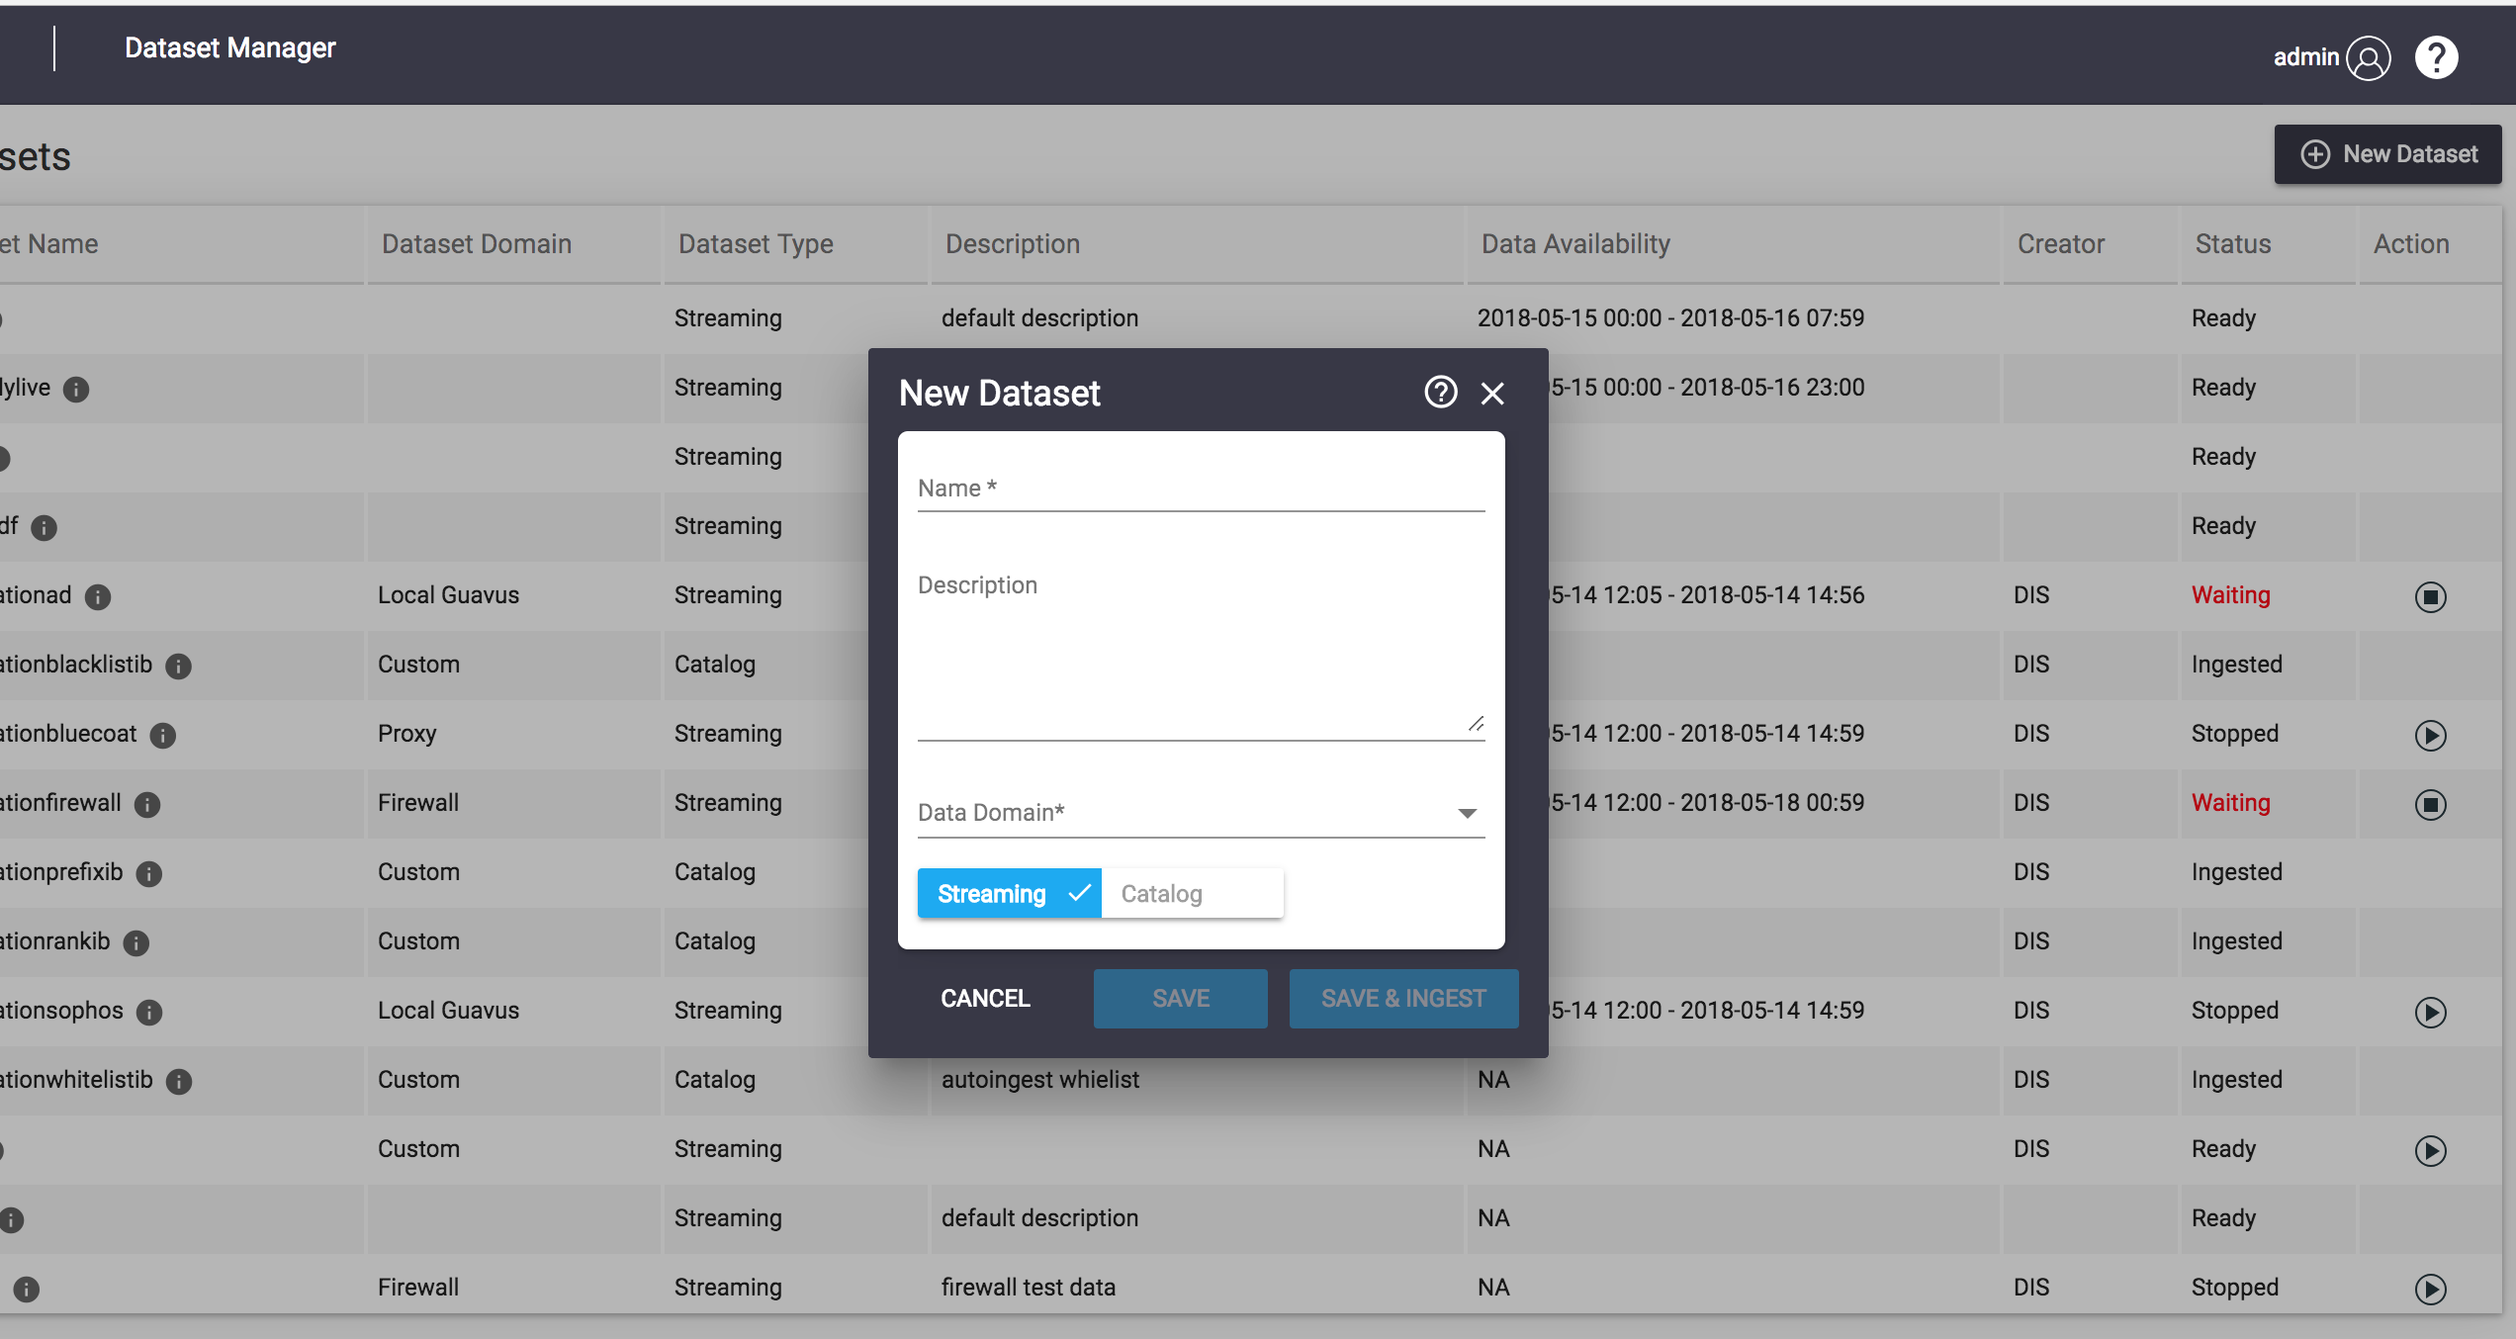
Dataset Manager App
DMA provides the versatile ingestion capabilities
DMA benefits:
Multiple format data ingestion
Varied Data Domain supported
Integrated with multiple data ingestion framework
Support both streaming and catalog data ingestion
Advance statistics enabled
Notes:
Developers also have the flexibility to write their MR, Spark jobs outside CDAP if its really needed. But we recommend to use CDAP for all data processing needs.

Slide 10
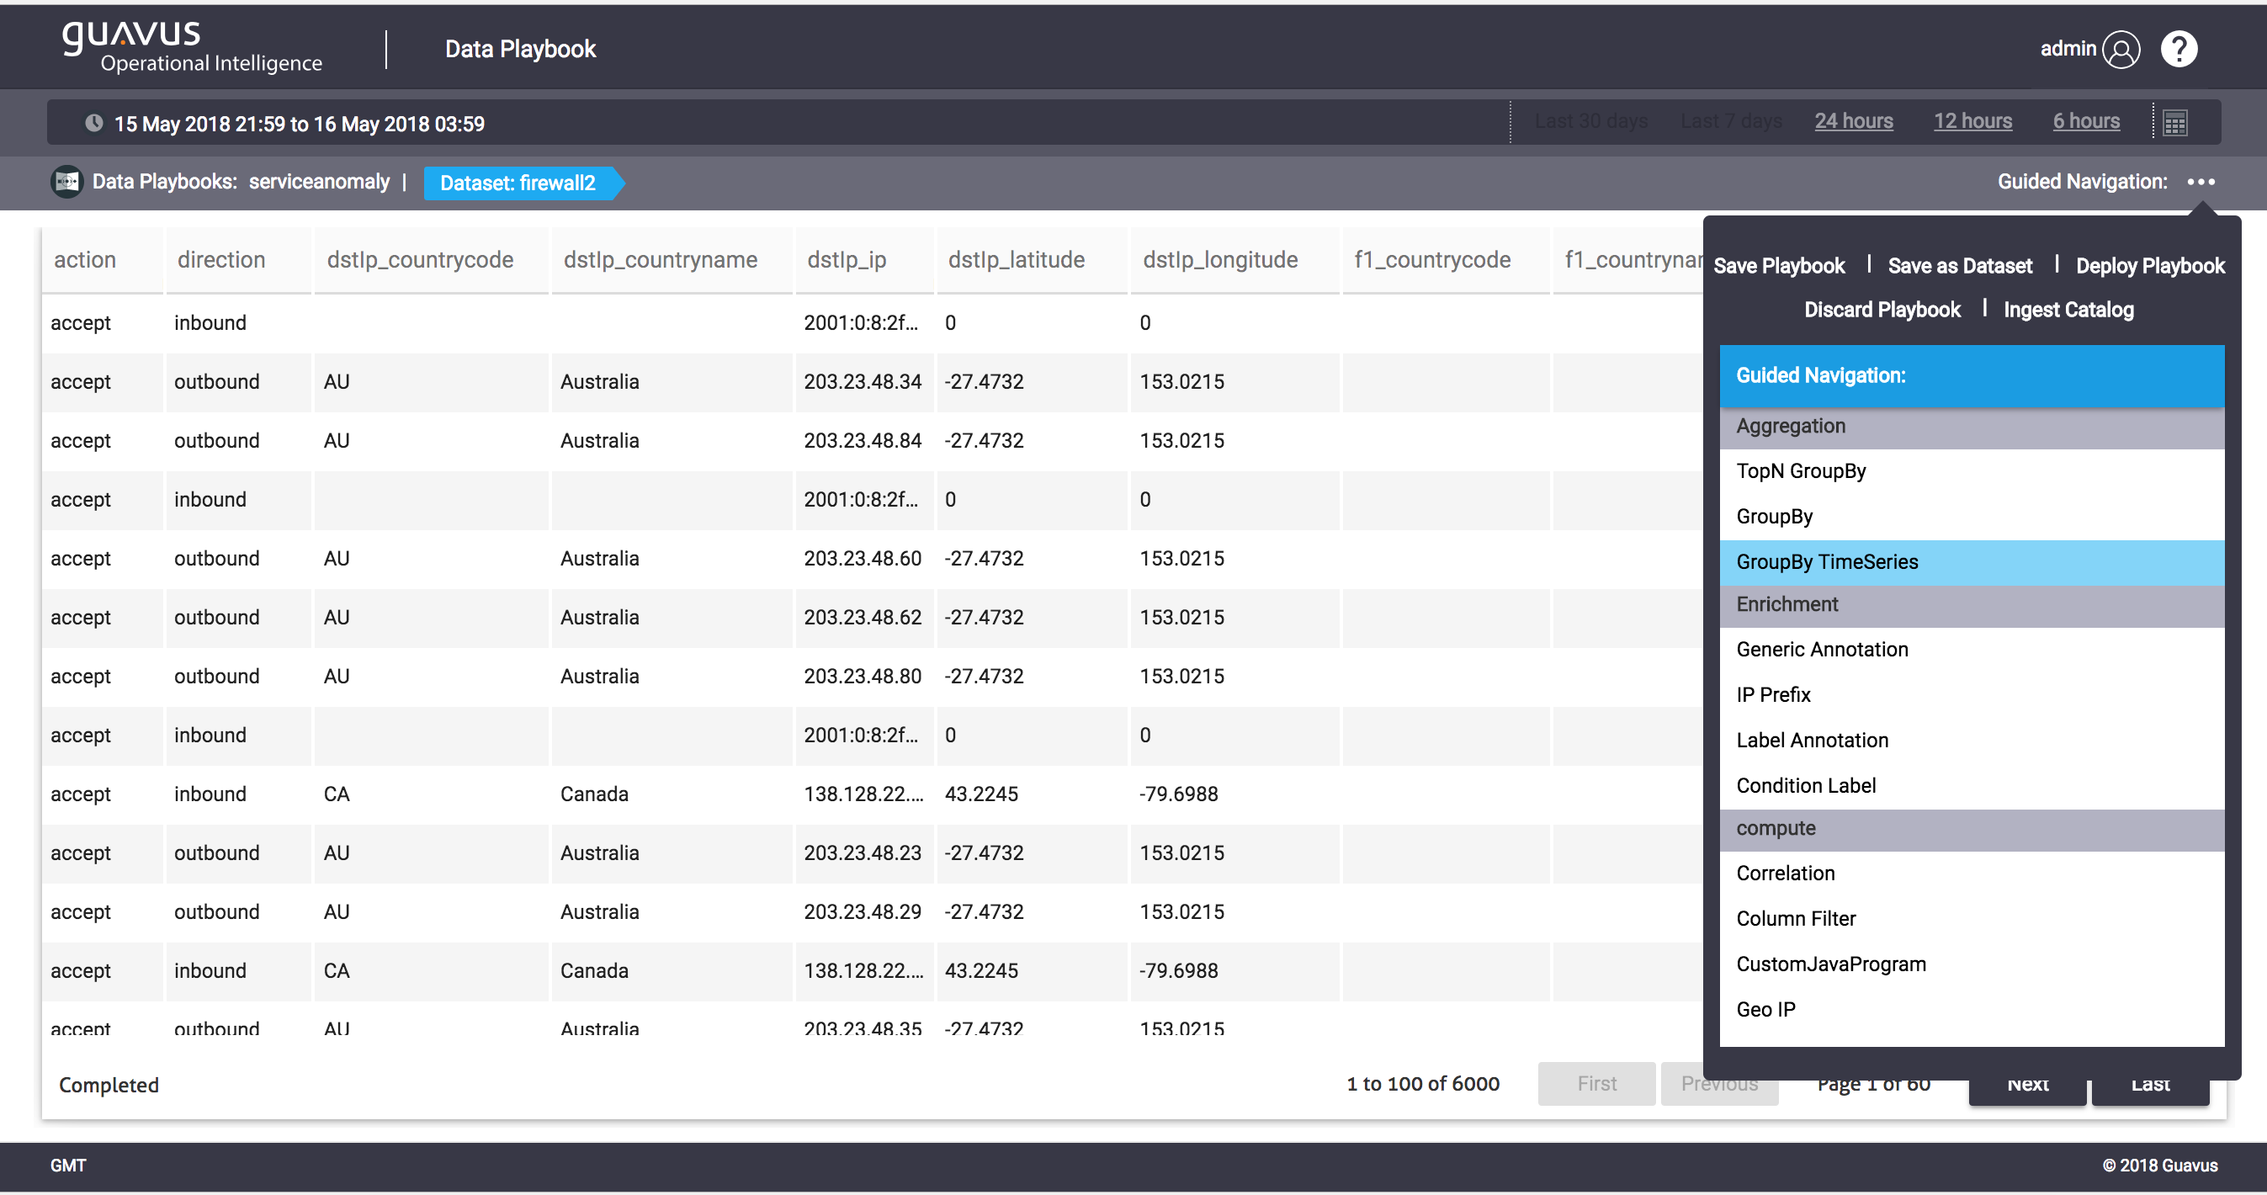
Data Playbook App
DPA provides the advance data exploration capabilities
DPA benefits:
Interactive Data Exploration
Interactive Data Visualization
Workflow building capability
Enabled with Advance Analytics
Accelerators
Notes:
Developers also have the flexibility to write their MR, Spark jobs outside CDAP if its really needed. But we recommend to use CDAP for all data processing needs.

Slide 11
Data Processing: Enrichment and Curation
Data Processing selection may be based on:
Batch/Streaming
Skill set (Java/Scala, MR/Spark Paradigm, MR/Spark API)
It is hard to build and deploy data processing pipelines.
So, Reflex
Simplifies data processing
Can use Mapreduce, Spark or Spark Streaming
UI for stitching pipelines

Slide 12
Data Processing: Analytics
Tools selection may be based on:
Data Exploration and Wrangling capabilities
Feature Engineering
Model Training
Model Management/Deploy
Notebook support
So, Reflex Integrates CDAP, Analytics modules/plugins, Model Management framework and Zeppelin.

Slide 13
Data Storage
Data storage choices may be based on:
Distributed File System
Columnar Store
Key-value Store
In-memory store
Graph store
Full text search store
RDBMS
No single storage is suitable to all kind of use cases.
So, Reflex integrates ElasticSearch, Redis, JanusGraph and Postgres.

Slide 14
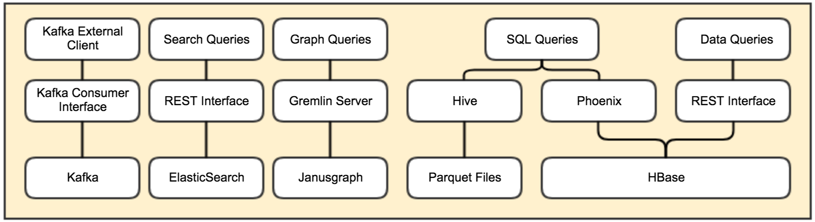
Data Access

Slide 15
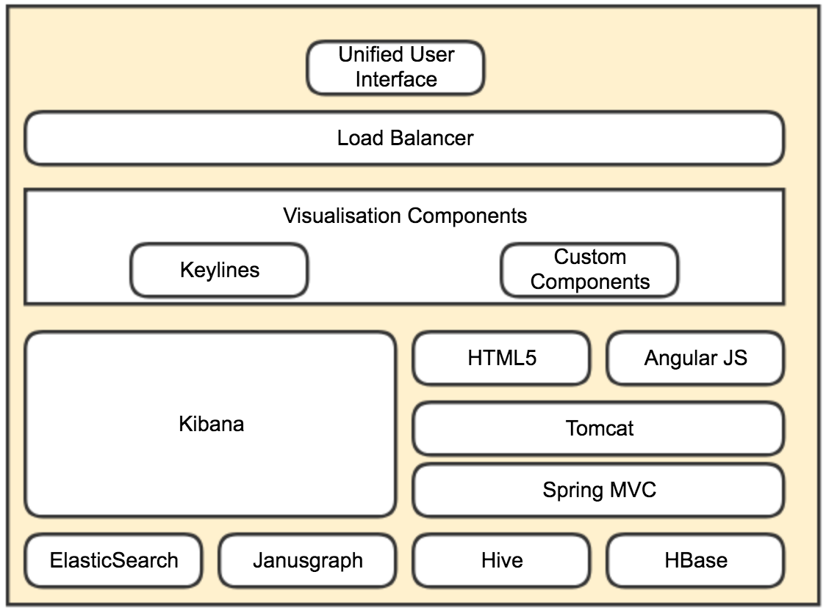


Data Consumption
Kibana/Superset

Slide 16
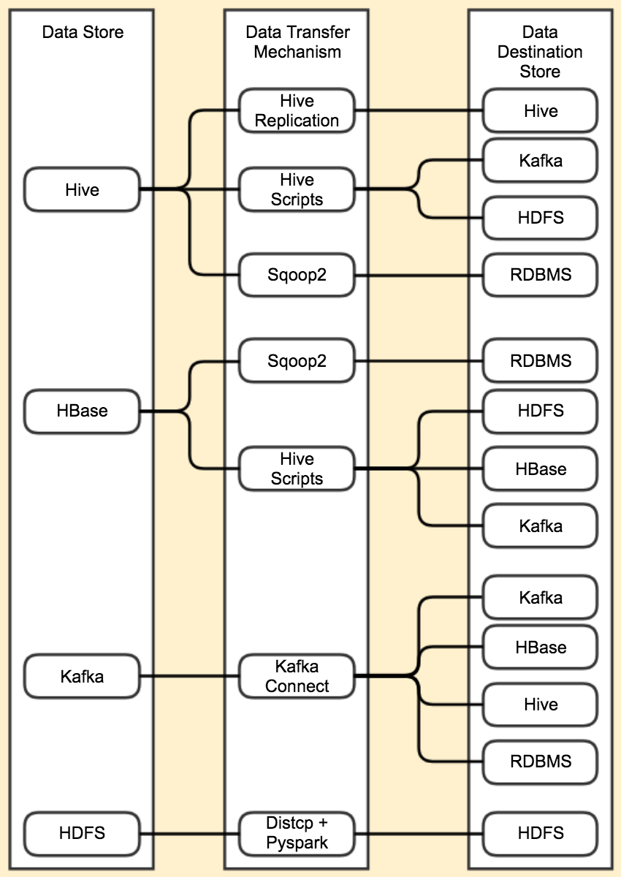
Data Export

Slide 17
Reflex Architecture
Security
App1
Dev Ops
App2
AppN
Ingestion Plugins
Data Processing Plugins
Analytics Plugins
User Interface Plugins
Authentication
Parsers
Graph
Rules Engine **
Continuous Integration
Authorization
Feature Primitives
ML Plugins
Components
Continuous Deployment**
Adaptors
Search
Source/
Sink
Encryption **
Test Automation
Key Management **
Analytics Engine **
User Interface Frameworks
OAM
Ingestion Frameworks
Data Processing Frameworks
Ingestion Service
Data Mgmt Service **
IB Mgmt
Feature Engineering
Model Management
Model Selection
UI Toolkit
Audit Logs
Provisioner
Collector
Interactive Execution
CDAP+
Model Deployment
ML Automation
Superset+ **
** Currently under development

Slide 18
HDP/HDF Components

Slide 19
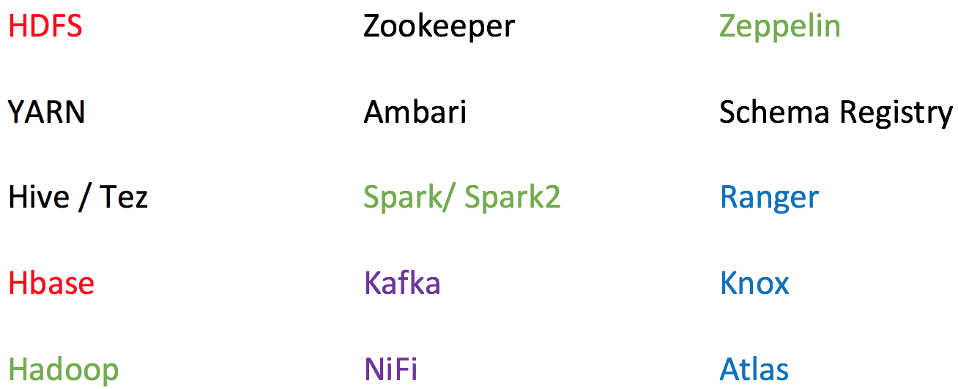
Hortonworks Stack
Base Tech Stack used in Reflex is Hortonworks HDP/HDF.
Open source policy
Ambari support
Data governance
Security through Knox and Ranger

Slide 20
Resource Management

Slide 21
Resource Management
YARN to manage resources for all Spark, Spark Streaming applications.
Resources supported by YARN are CPU and Memory
Kubernetes to manage Containers and their resources.
Resources supported by Kubernetes are CPU, Memory

Slide 22
YARN
Central to Hadoop Clusters.
Multi-tenancy
Cluster Utilization
Scalability
Notes:
https://2xbbhjxc6wk3v21p62t8n4d4-wpengine.netdna-ssl.com/wp-content/uploads/2014/10/YARN-with-Slider.png

Slide 23
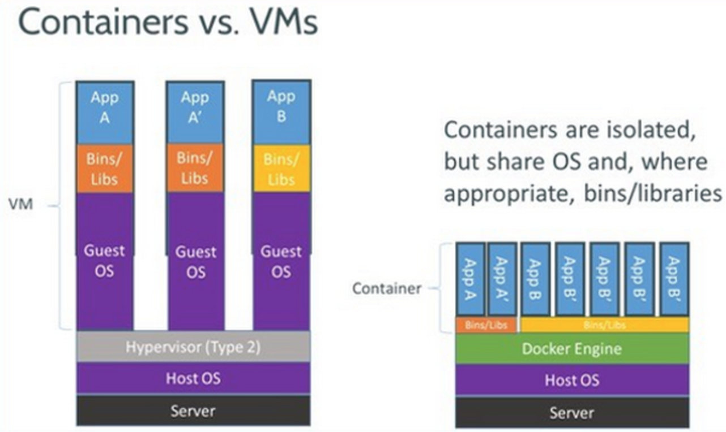
Docker
Allows users to package an application with all of its dependencies into a standardized unit.
Lightweight
Isolation
Simplicity
DevOps
Micro-services

Slide 24
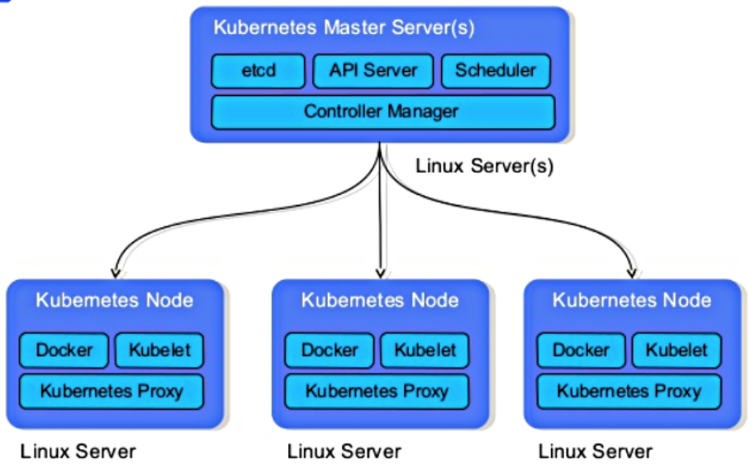
Kubernetes
Provides a container-centric management environment.
It orchestrates computing, networking, and storage infrastructure on behalf of user workloads.
Features:
Intelligent Scheduling
Self-healing
Horizontal scaling
Storage orchestration
Load balancing
Automated rollouts and rollbacks
Batch Execution

Slide 25
Ingestion/Collection

Slide 26
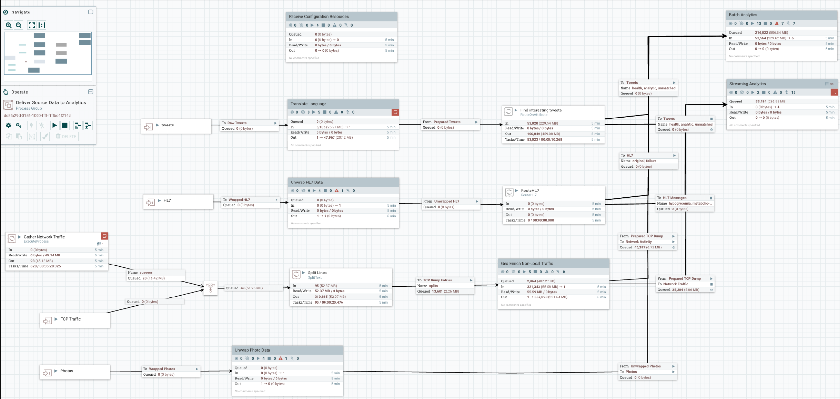
NiFi
Apache NiFi supports powerful and scalable directed graphs of data routing, transformation, and system mediation logic. Some of the high-level capabilities and objectives of Apache NiFi include:
Web-based user interface
Highly configurable
Data Provenance
Designed for extension
Secure
Notes:
Web UI for designing pipelines and offer data provenance, performance around transformation is limiting and no complex processing like aggregations etc, allows a developer to change pipelines dynamically.

Slide 27
Talend
Open Source
Eclipse based developer tooling to design jobs
Orchestrate dataflows and integrations
Ingestion, loading and unloading of data into data lake
Notes:
talend has simillar capabilities as nifi but only supports, desktop based tool, u cant change pipelines on runtime. At least with the open source version.

Slide 28
LogStash
Logstash is a light-weight, open-source, server-side data processing pipeline that allows you to collect data from a wide variety of sources, transform it on the fly, and send it to your desired destination.
It is most often used as a data pipeline for ElasticSearch.
Easily Load Unstructured Data
Pre-built Filters
Flexible Plugin Architecture
Notes:
logstash beats everybody for semi-structured data, and list of available pluings are huge, best suited for log type data.

Slide 29
Guavus Collector
Best performance per core
GenericAdaptor
Batch and Streaming
HDFS
Kafka
Notes:
Best per core processing capacity, works with huge volumes of structured data.
These frameworks are not mutually exclusive. You might use multiple of them in an application.

Slide 30
Ingestion
These tools/frameworks are not mutually exclusive.
You may choose to run multiple for an application.
The choice will depend on use case.

Slide 31
Data Bus

Slide 32
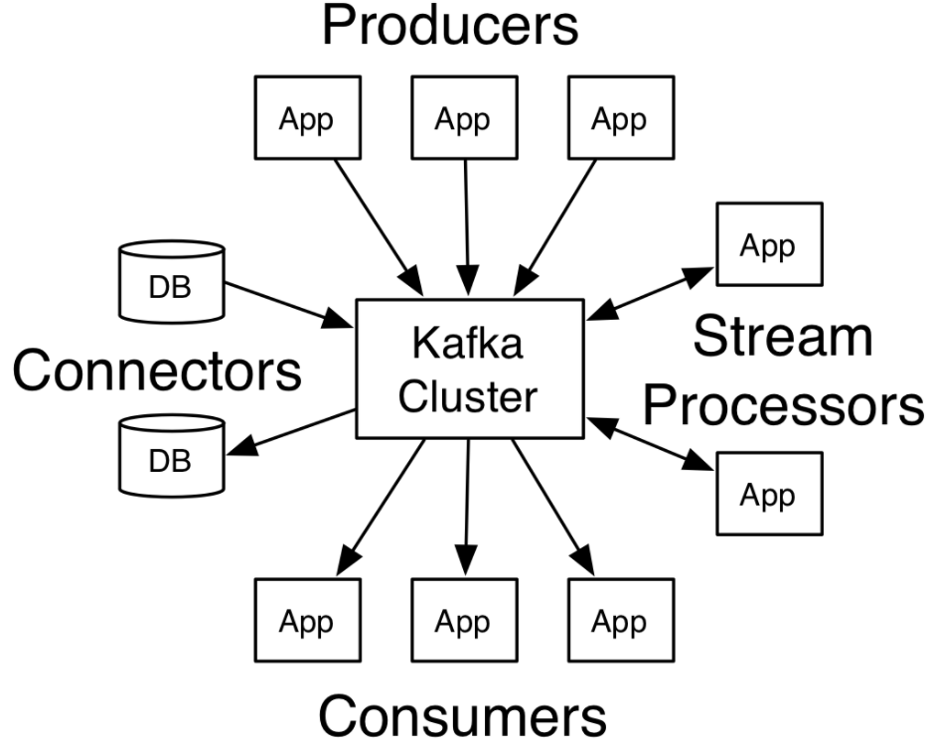
Kafka
Apache Kafka is a distributed streaming platform.
A Streaming platform has key capabilities:
Pub-Sub (allow data democratization)
Fault-tolerance and Durable
Low Latency
Scalable by adding more nodes
Integrates with most big data frameworks

Slide 33
Data Storage

Slide 34
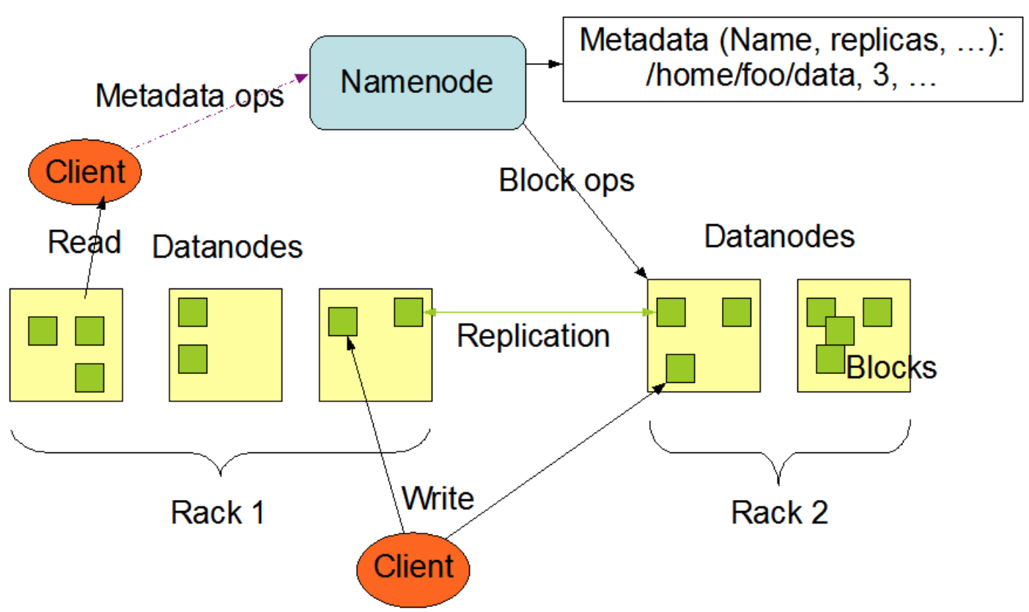
HDFS

Slide 35
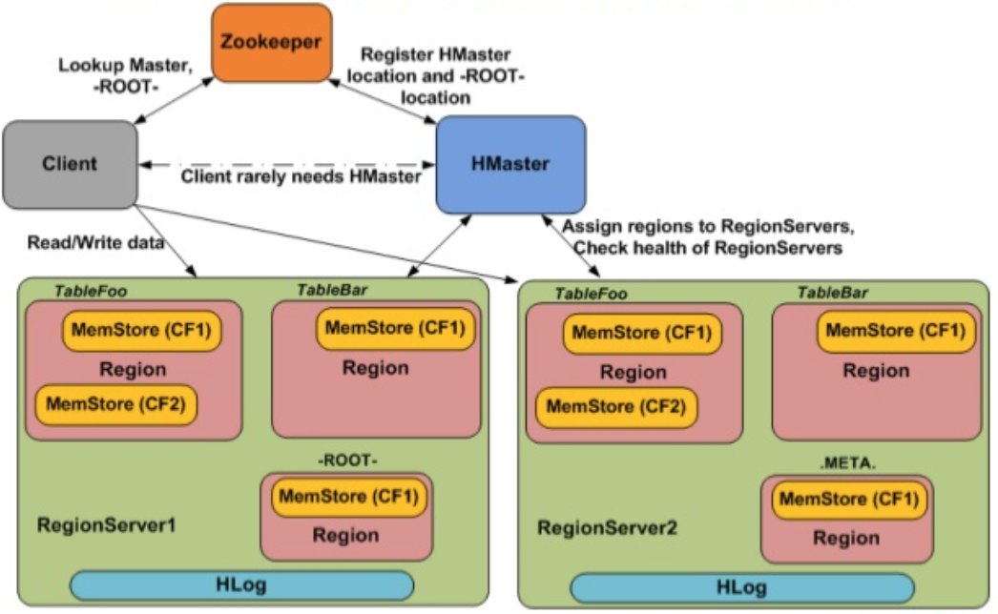
HBase
HBase is the Hadoop database, a distributed, scalable, big data store.
Key features:
Fast random, real-time R/W access
Versioned
Strictly consistent
NoSql
Highly Available
Based on BigTable

Slide 36
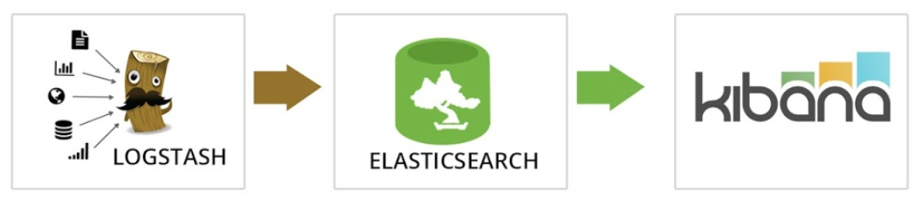
ElasticSearch
Elasticsearch is an open-source, RESTful, distributed search and analytics engine built on Apache Lucene.
When coupled with Kibana, a visualization tool, Elasticsearch can be used to provide near-real time analytics using large volumes of log data.
ES benefits:
Fast
Easy to Use
Complementary tooling
Near real-time index update
Support for many languages

Slide 37
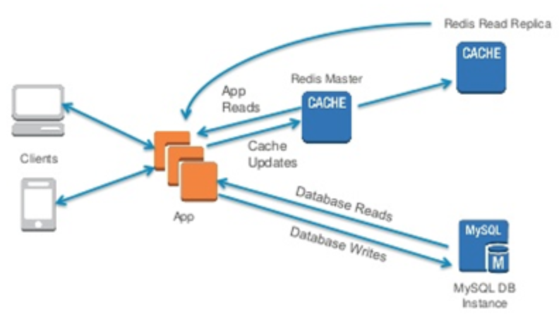
Redis
Redis is an open source, in-memory data structure store, used as a database, cache and message broker (pub-sub).
Support rich data types.
Built-in replication
LRU eviction
Transactions and
On-disk persistence.
Spark Jobs do not manage state across executions. So Redis can be used to manage state in such use cases.

Slide 38
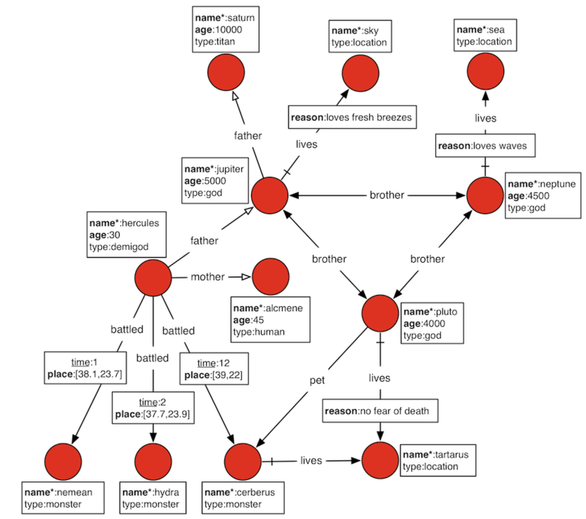
JanusGraph/Gremlin
JanusGraph is a scalable graph database optimized for storing and querying graphs containing hundreds of billions of vertices and edges distributed across a multi-machine cluster.
Gremlin is a graph traversal language.

Slide 39
RAF | Data Model Choices
Choose the right tool for the job.
Data Model | Storage/DB
Distributed File System | HDFS
Columnar | HDFS (Parquet/ORC)
Key-value | HBase
In-Memory Key-Value | Redis
Search | ElasticSearch
Graph | GanusGraph
Relational | Postgres

Slide 40
Processing & Workflow Management

Slide 41
CDAP
CDAP is the unified integration platform for big data.
CDAP benefits:
High level and easy to Use
Faster time to market
Build once and run anywhere
Enterprise ready
Wrangling
Model training
Notes:
Developers also have the flexibility to write their MR, Spark jobs outside CDAP if its really needed. But we recommend to use CDAP for all data processing needs.

Slide 42
Guavus CDAP Accelerators
CDAP plugins for extending CDAP capabilities.
Some of the plugins are as below:
Elastic Source/Sink
Kafka Source/Sink
JanusGraph Source/Sink
PublishService
Record Enrichment and Timeseries Enrichment
Timeseries Anomaly Detection
Rules Engine
MLPipeline Predictor
…

Slide 43
Zeppelin
Web-based notebook that enables interactive data analytics.
Model Training

Slide 44
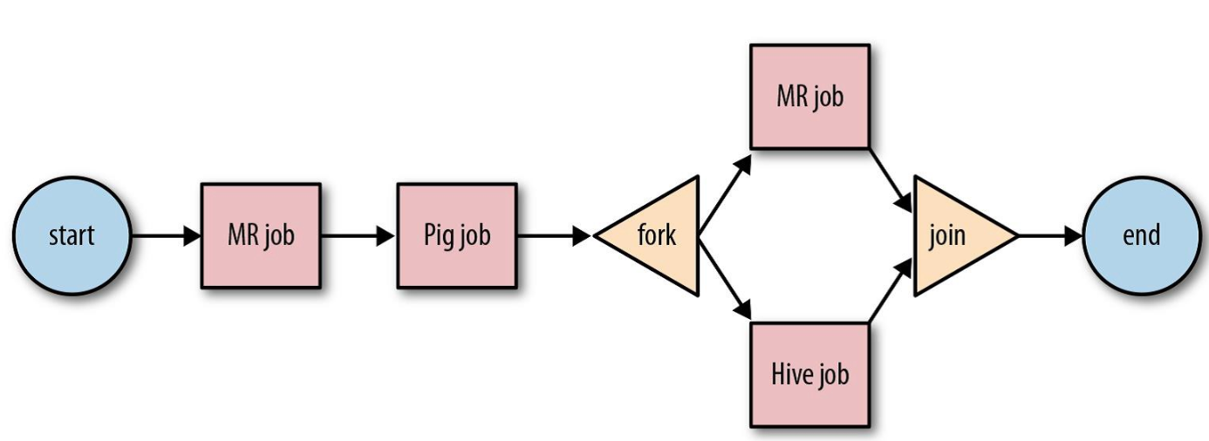
Oozie
Oozie is a workflow scheduler system to manage Hadoop jobs
Oozie workflow jobs are DAG of actions.
Can be scheduled to be triggered by time or data availability.
Supports out of box
MR
Pig/Hive
Scoop
Distcp
Shell Script etc…
Notes:
You may choose to hide this slide.

Slide 45
Provisioning in RAF

Slide 46
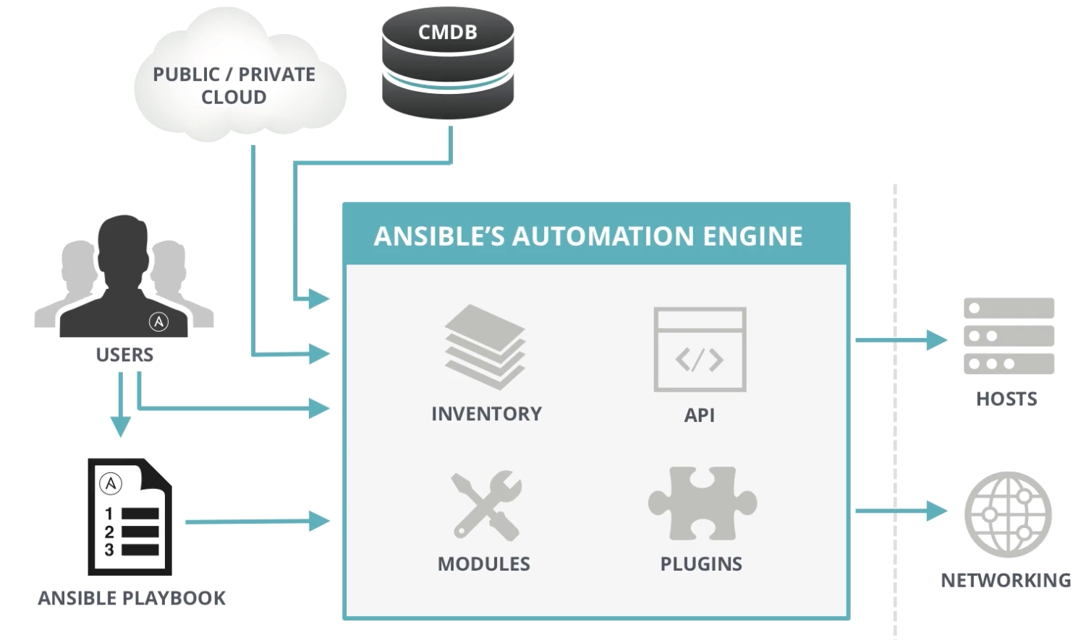
Ansible | Application Deployment and Config Management
Automates software provisioning, configuration management, and application deployment.
No Agents; connects via SSH
Plugins support
Dry run
…

Slide 47
Ambari (Provisioning and Management of HWX stack)
Simplifies provisioning, managing, and monitoring Apache Hadoop clusters.
Ambari provides an intuitive, easy-to-use Hadoop management web UI backed by its RESTful APIs.
Integrates most Hadoop ecosystem
Highly extensible and customizable
Centralized Security
Visibility into cluster health

Slide 48
Operations, Administration and Management

Slide 49
Reflex OAM
Installation - Ambari or Ansible
Log Management - Fluentd + ES + Kibana
Management and Basic Operations Monitoring - Ambari, Kubernetes Dashboard/CLI
Detailed Monitoring (Debugging Metrics) - Grafana

Slide 50
RoadMap Items?

Slide 51
Summary (1)
Makes it easy to build end-to-end big data applications.
Multiple data ingestion tool choices (per use case)
Simplifies data processing
Analytics
Notebook support
Model Management Framework
Model Deployment
Extends data model portfolio with:
For search use cases (ES)
For graph use cases (JanusGraph)
For in-memory key-value store (Redis)
Notes:
Components/Tools to build end-to-end big data applications
Organizations have invested in build data lakes but they are not able to optimally leverage them because of lack of tools/applications/frameworks that allow them to build applications on top of the data lake. RAF allows you to leverage your data warehouse/data lakes by providing you end-to-end big data application development tools/components/integrations.

Slide 52
Summary(2)
7. Data Bus (Kafka) based processing
8. UI
UI Toolkit(HTML5/Angular)
SuperSet+/Kibana for presentation layer
9. Due diligence before tool/framework integration
10. Allows you flexibility to integrate specific tools with Kubernetes/Docker.

Slide 53
Quiz

